Slide 1

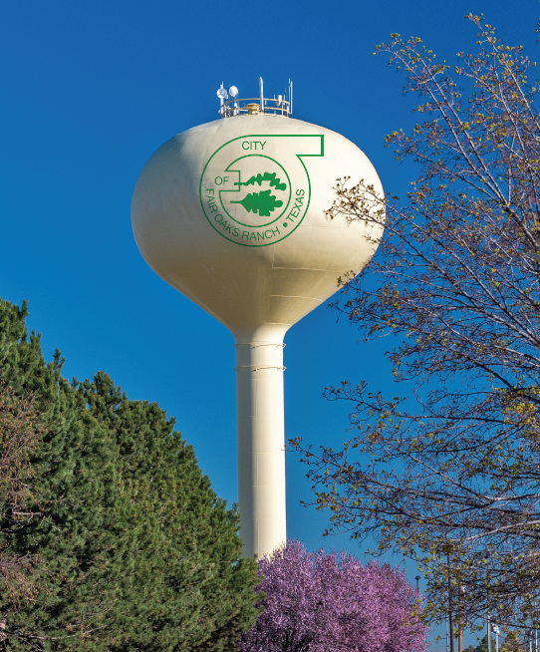


City of Fair Oaks Ranch, TX
Elevated Storage Tank Project
Community Workshop #2
September 10, 2019

Slide 2
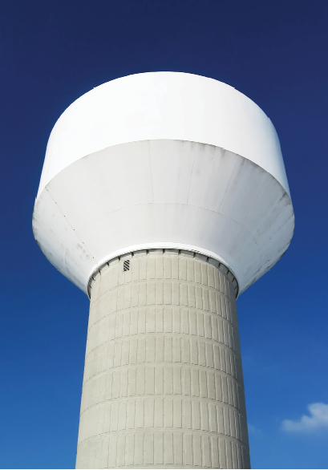
Table of Contents
Introduction
Background on Elevated Storage Tank
Community Workshop #1
Potential Tank Location
Site and Tank Style Cost Analysis
Stakeholder Update
Overview of Project Schedule
Workshop Agenda and Expectations

Slide 3
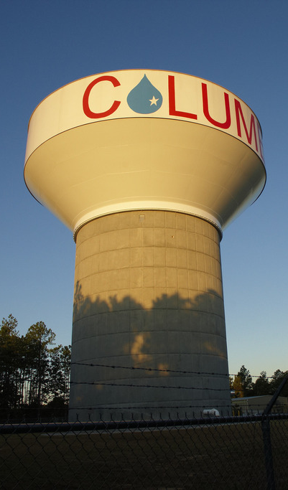
Background on Elevated Storage Tank Benefits of Elevated Storage
Maintains constant water supply and pressure for public and fire flow demands
Operational flexibility during emergencies and provides additional water storage during peak water demands and droughts
Operational Cost Savings – Reduced pumping
Long-term Savings – Less pump capacity needed
Lower Risk – Able to meet system demands in power outage

Slide 4
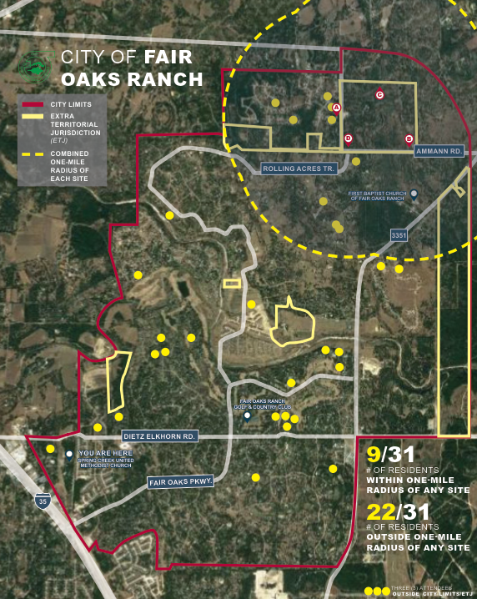
Community Workshop #1
Hosted at Spring Creek United Methodist Church on June 18, 2019
34 Total Attendees
31 City of Fair Oaks Ranch Residents
9 Residents identified as living within 1-mile radius of any four potential tank sites

Slide 5
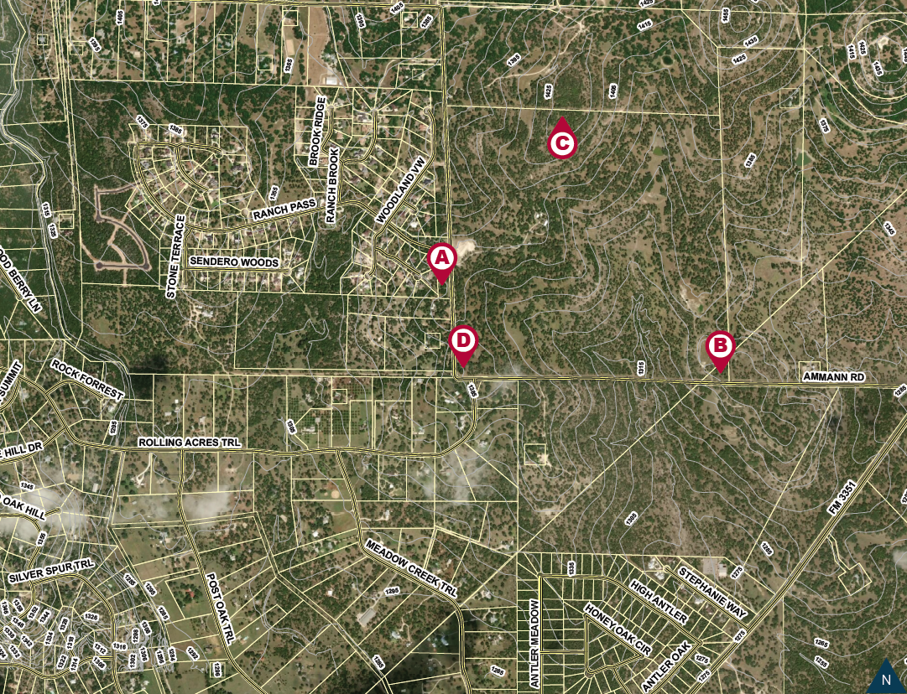
Station 1: Potential Tank Location

Slide 6
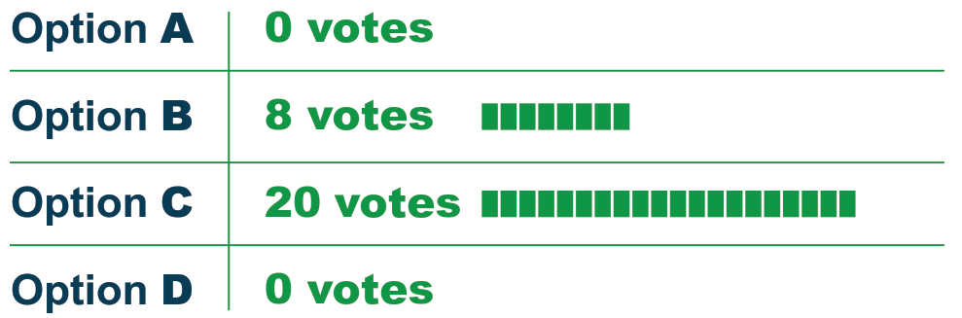
Community Workshop #1: Potential Tank Site Results
Feedback Received:
Strong preference for avoiding sites immediately adjacent to existing residences.
Preference for installing the tank at higher elevation, to reduce the overall height of the tank (and potential construction cost).

Slide 7

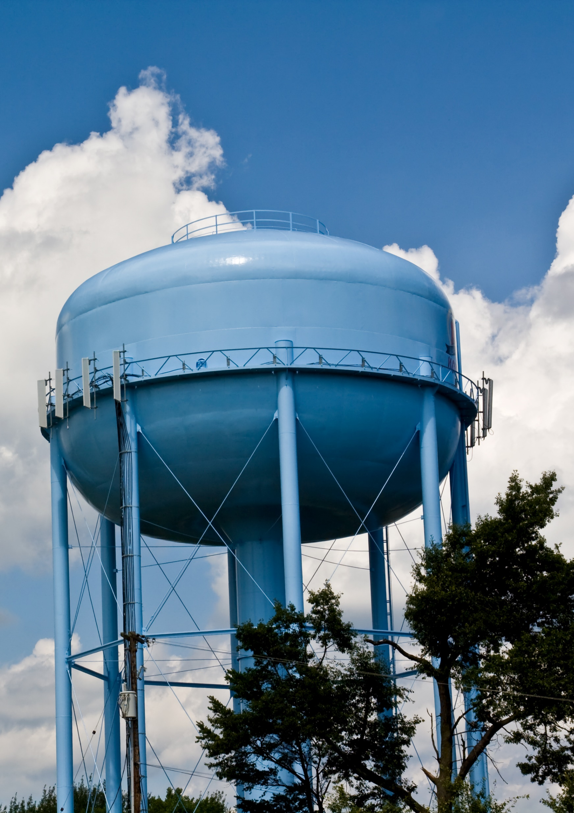
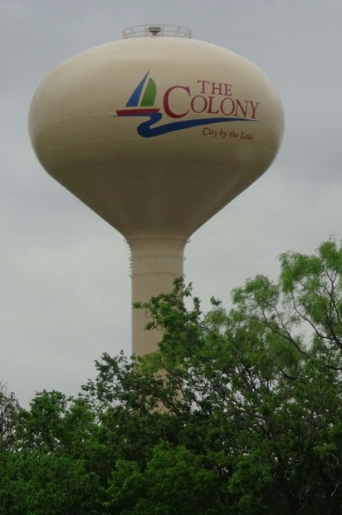
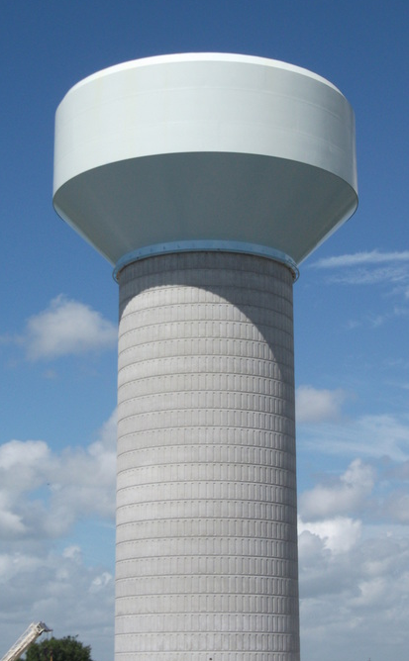
Potential Tank Styles
Multi-Column
Spheroid
Composite

Slide 8
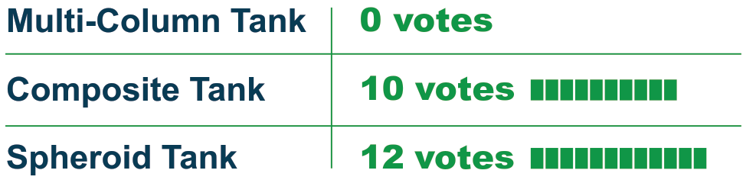
Community Workshop #1: Tank Design Results

Slide 9
Tasks Performed Since Last Workshop
Tank Site Evaluation
Engineering Analysis
Water System Modeling
Projected Construction Costs
Tank Style Evaluation
Capital Costs
Long Term Maintenance Costs
Stakeholder Outreach

Slide 10
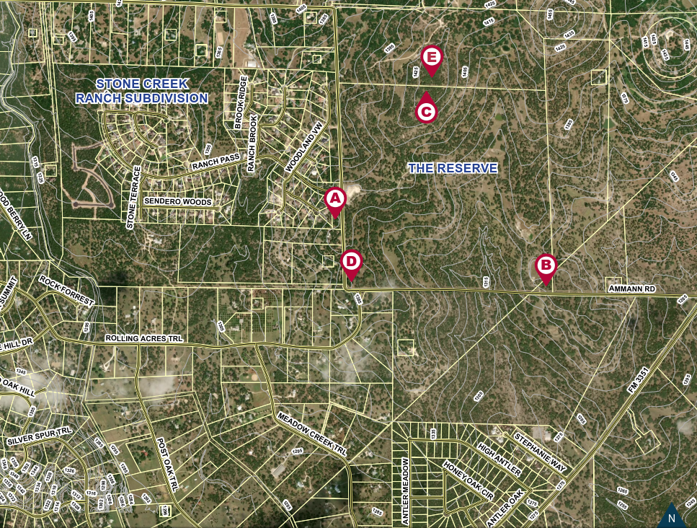
Potential Tank Location

Slide 11
Site A – Ground Elevation: 1382 feet
Tank Height to overflow: 150 feet
Waterline extension required: 225 feet
Access via Ammann Rd
Three-phase electric power available
Existing berm – significant grading and drainage analysis required
Approx. 150 feet to closest residential structure
Opinion of Probable Construction Cost
Various Tank Styles | $2.2 – $2.8 M

Slide 12
Site B – Ground Elevation: 1357 feet
Tank height to overflow: 170 feet (Tallest tank)
Waterline extension required: 3,650 feet (Longest pipe extension)
Access via Ammann Rd
Three-phase electric power available
Location of future City Pump Station
Approx. 2,600 feet to closest residential structure
Opinion of Probable Construction Cost
Various Tank Styles | $2.9 - $3.5 M

Slide 13
Site C – Ground Elevation: 1432 feet
Tank height to overflow: 100 feet
Waterline extension required: 1,950 feet
Access off Ammann Road – Approx. 1,700 feet of access road required
Single-phase electrical line extension required: 350 feet
Approx. 1,100 feet to closest residential structure
Opinion of Probable Construction Cost
Various Tank Styles | $2.4 - $3.0 M

Slide 14
Site D – Ground Elevation: 1390 feet
Tank height to overflow: 140 feet
Waterline extension required: 200 feet
Access via Ammann Rd
Three-phase electric power available
Approx. 380 feet to closest residential structure
Opinion of Probable Construction Cost
Various Tank Styles | $2.1 - $ 2.7 M

Slide 15
Site E – Ground Elevation: 1435 feet
Tank height to overflow: 95 feet (Shortest tank)
Waterline extension required: 2,200 feet
Access off Ammann Rd – Approx. 1,950 feet of access road required
Single-phase electrical line extension required: 380 feet
Approx. 750 feet to closest residential structure
Opinion of Probable Construction Cost
Various Tank Styles | $2.5 - $3.1 M

Slide 16
Capital Cost by Tank Style
Multi-Column
Lowest Cost
Spheroid
Middle Cost
Composite
Highest Cost

Slide 17
Site/Tank Style Analysis: Construction Cost Comparison*
Site Locations | Composite | Spheroid | Multi-Column
Site A | $2,800,000 | $2,600,000 | $2,200,000
Site B | $3,500,000 | $3,300,000 | $2,900,000
Site C | $3,000,000 | $2,700,000 | $2,400,000
Site D | $2,700,000 | $2,400,000 | $2,100,000
Site E | $3,100,000 | $2,800,000 | $2,500,000
Lowest Overall Construction Cost: Site D, Multi-Column
*Construction costs include estimates for a water elevated storage tank, site work, electrical and controls, mobilization, and off-site work including access roads, extension of existing utilities, and drainage. Land acquisition costs are not included.

Slide 18
Life Cycle Cost by Tank Style*
Composite
Lowest Cost
$220,000/repaint
Spheroid
Middle Cost
$300,000/repaint
Multi-Column
Highest Cost
$330,000/repaint
*Life cycle costs were created assuming a 60-year life cycle, with repaints every 15 years.

Slide 19
Stakeholder Update
Federal Aviation Administration
Pedernales Electric Cooperative
Kendall and Comal County
Guadalupe-Blanco River Authority
Camp Bullis and Camp Stanley Military Installations
Stone Creek Ranch, Boerne Ranch Estates, and Zoeller family

Slide 20
Overview of Project Schedule
Community Workshop #2 – Tuesday, September 10, 2019
City Council Approves Final Tank Site – November 21, 2019
Design Completion – August 2020
Construction Begin – November 2020
Construction Completion – November 2021
*Subject to change

Slide 21
Workshop Agenda and Expectations
Station 1
Potential Tank Locations
Station 2
Site/Tank Evaluation Criteria
Aesthetics (Tank Styles)
Construction Impacts and Future Operational Impacts
City’s Long-Term Master Plan
Permit/Approvals

